Slide 1



UNIT 4
LESSON 13
Living online
Part 4

Slide 2
Nomophobia?
Phubbing?
no mobile phone phobia
Ringxiety?
phone + snubbing= snubbing/ignoring someone because of the phone.
ring + anxiety

Slide 3
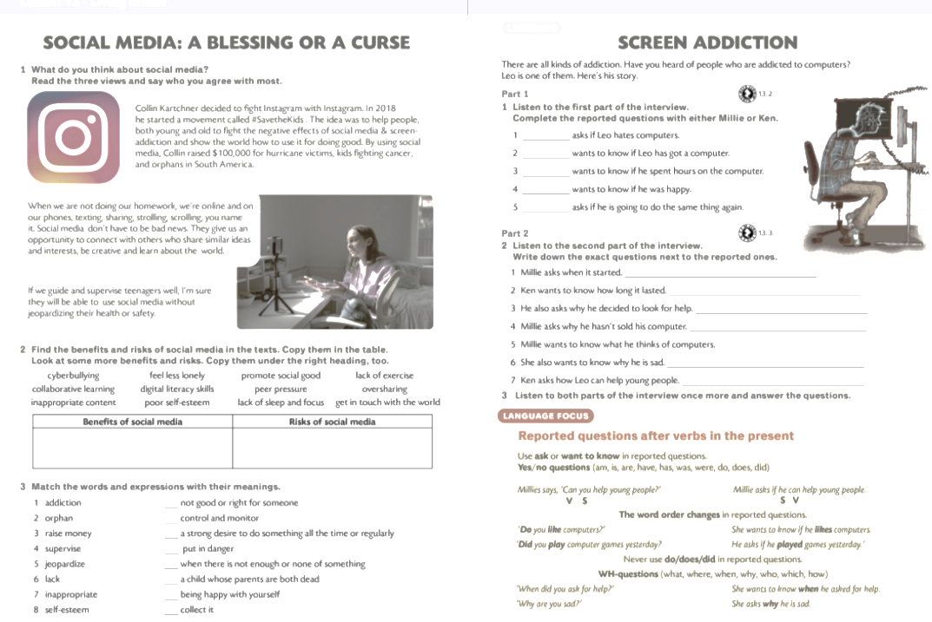

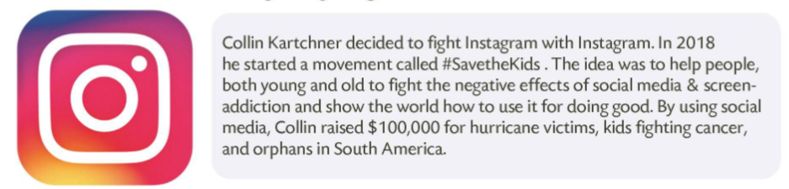
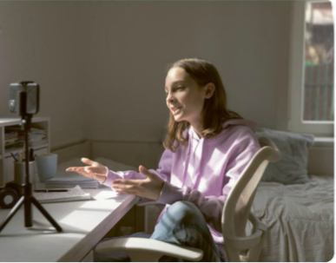
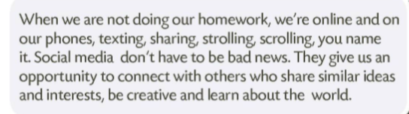

Slide 4
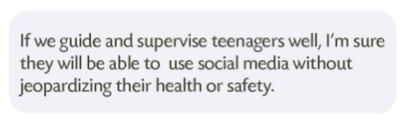
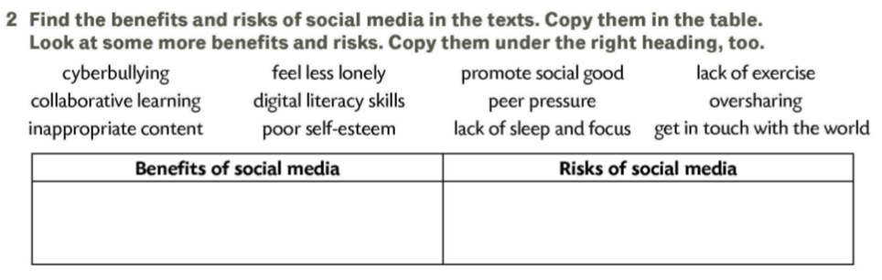
feel less lonely
be creative
peer preasure
raising money
screen addiction
cyberbullying
promote social good
collaborative learning
lack of exercise
oversharing
digital literacy skills
inappropriate content
poor self-esteem
get in touch with the world
lack of sleep and focus

Slide 5
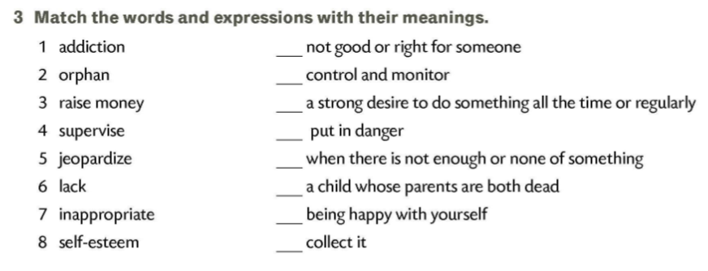
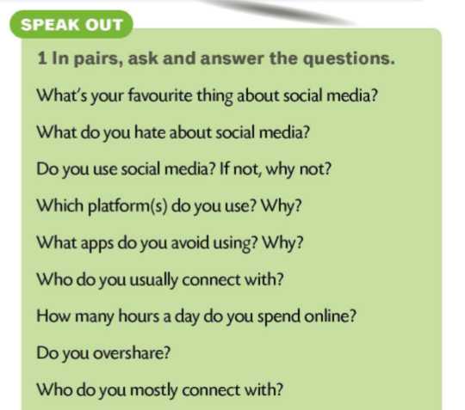
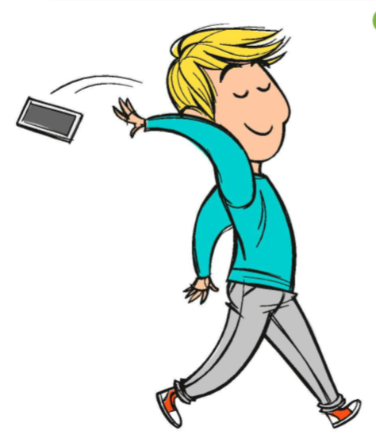

7
4
1
5
6
2
8
3

Slide 6
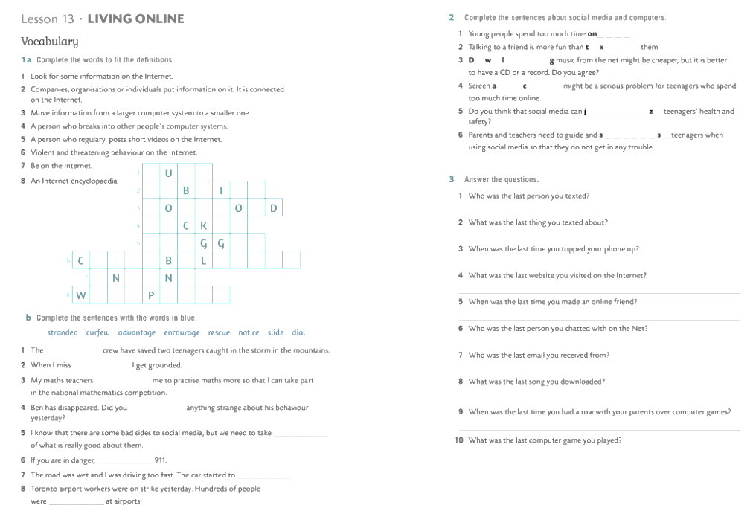
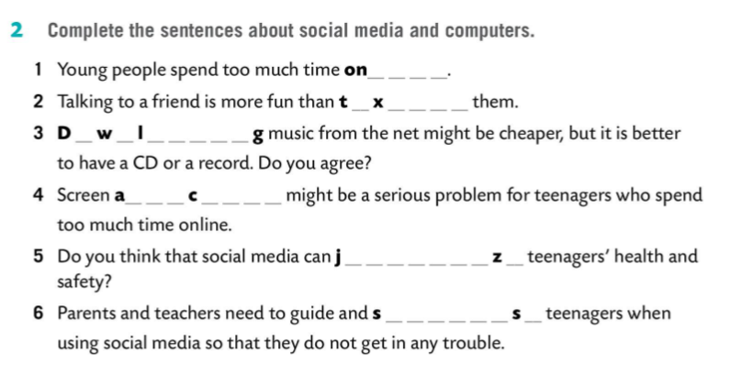
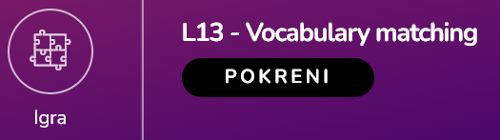
online
texting
Downloading
addiction
jeopardize
supervise

